Slide 1
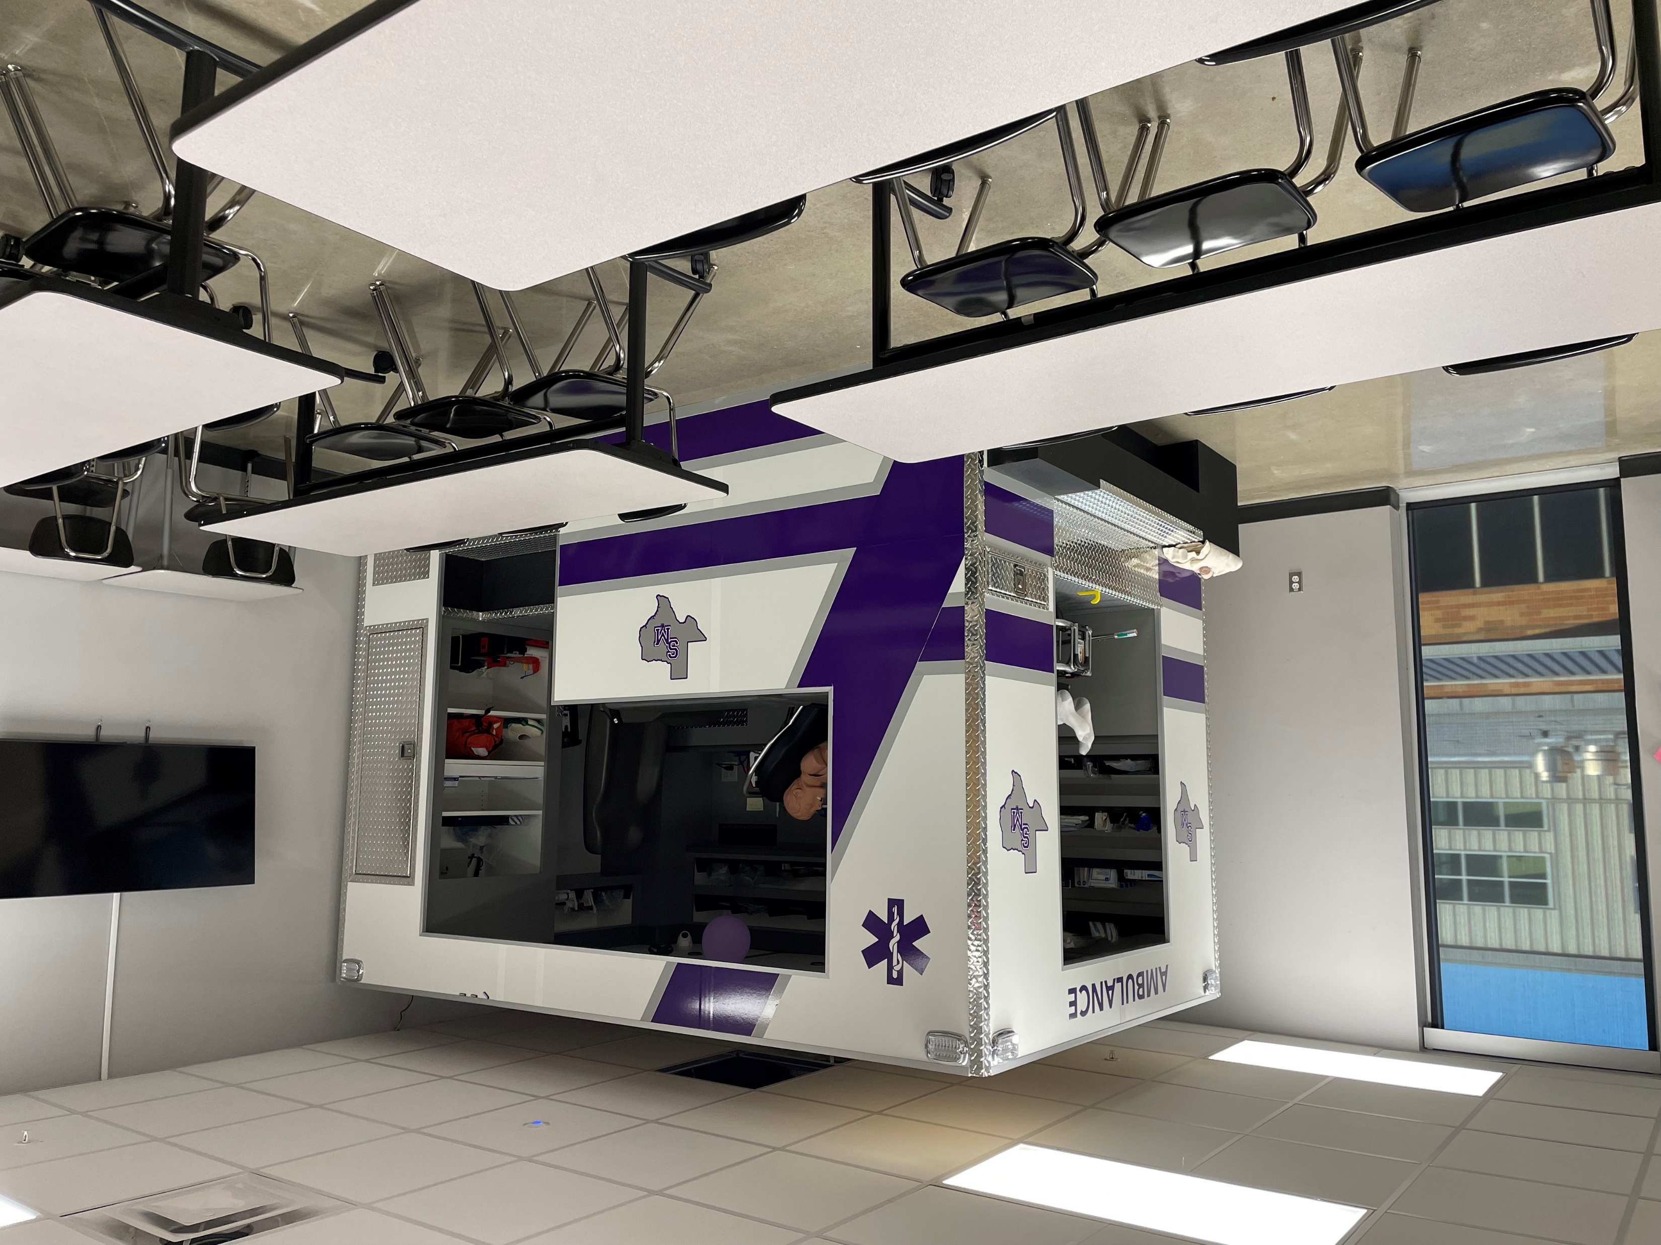
Nursing Science (Emergency Medical Technician)
Statewide Program of Study
Health Science Career Cluster
The Health Science Career Cluster focuses on planning, managing, and providing therapeutic services, diagnostics services, health informatics, support services, and biotechnology research and development. To pursue a career in the health science industry, students should learn to reason, think critically, make decisions, solve problems, communicate effectively, and work well with others.
The Nursing Science program of study introduces students to the knowledge and skills related to patient care. CTE learners may learn about or practice caring for patients, routine procedures such as monitoring vital signs, development and implementation of care plans, maintenance of medical records, and disease or pain management. Students may focus on the healthcare system and research system designs and make recommended modifications.
Work-Based Learning and
Expanded Learning Opportunities
Secondary Courses for High School Credit
1 Principles of Health Science
2 Medical Terminology
3 Anatomy and Physiology
4 Emergency Medical Technician
Exploration Activities | Work-Based Learning Activities
Participate in Health Occupation Students of America | Volunteer at a community wellness center, hospital, assisted living center, or nursing home
Industry-Based Certifications
Emergency Medical Technician - Basic
Postsecondary Opportunities
Associates Degrees
Registered Nursing/Registered Nurse
Bachelor’s Degrees
Informatics Nurse Specialists
Master’s, Doctoral, and Professional Degrees
Nurse Practitioner
Nursing Administration
Nurse Anesthetist
SMHS Health Science Clinic
Aligned Occupations
Occupations | Median Wage | Annual Openings | % Growth
Licensed Vocational Nurses | $45,178 | 7,186 | 21%
Registered Nurses | $68,682 | 17,493 | 26%
Nurse Practitioners | $107,827 | 977 | 50%
Nurse Anesthetists | $154,856 | 357 | 23%
Successful completion of the Nursing Science program of study will fulfill requirements of a Public Service endorsement or STEM endorsement if the math and science requirements are met. Revised – August 2022

Slide 2
Nursing Science Course Information
COURSE NAME | SERVICE ID | PREREQUISITES | COREQUISITES
Principles of Health Science | 13020200 (1 credit) 6401 | None | None
Medical Terminology | 13020300 (1 credit) 6411 | Principles of Health Science | None
Anatomy and Physiology | 13020600 (1 credit) 3266 | Biology and a second science credit | None
Emergency Medical Technician | N1303015 (2 credits) 6414 | Biology, Principles of Health Science, and Medical Terminology | None
FOR ADDITIONAL INFORMATION ON THE HEALTH SCIENCE CAREER CLUSTER,
PLEASE CONTACT: CJ Odam, SMCISD CTE Coordinator cj.odam@smcisd.net
San Marcos CISD does not discriminate on the basis of race, color, national origin, sex, disability or age in its programs or activities and provides equal access to the Boy Scouts and other designated youth groups. The following person has been designated to handle inquiries regarding the nondiscrimination policies: Stephanie Munoz ; 631 Mill St, San Marcos, TX 78666 ; 512-393-6700 ; stephanie.munoz@smcisd.net
Further nondiscrimination information can be found at smcisd.net/cte

